Slide 1

Machine Learning
Classification, Clustering

Slide 2
Feedback is greatly appreciated!

Slide 3
Objective
What is Machine learning?
Supervised Learning
Classification
Regression
Unsupervised Learning
Clustering
Dimensionality Reduction
Semi-Supervised Learning
Reinforcement Learning

Slide 4
What is Machine Learning?

Slide 5
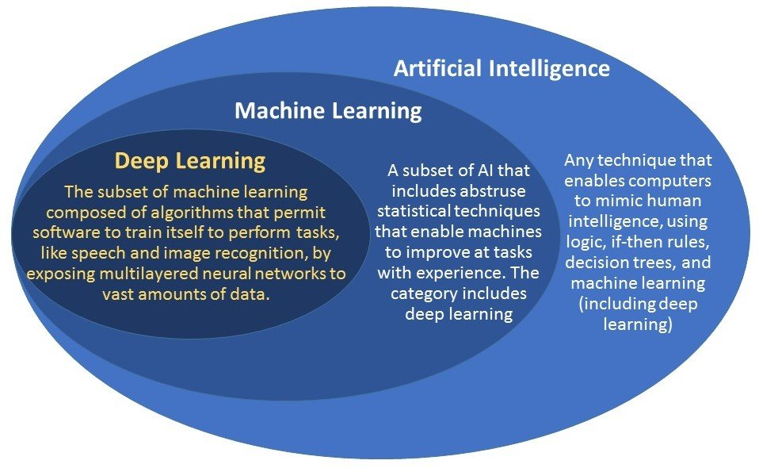
Machine Learning
Is the scientific study of algorithms and statistical models that computer systems use to effectively perform a specific task
ML algorithms builds a mathematical “model” from sample data, known as "training data", in order to make predictions or decisions

Slide 6
What is it used for?
Fraud detection
Web search results
Real-time ads on web pages
Credit scoring and next-best offers
Prediction of equipment failures
Network intrusion detection
Recommendation Engines
Text Sentiment Analysis
Predicting Customer Churn
Pattern and image recognition
Email spam filtering
Financial Modeling

Slide 7
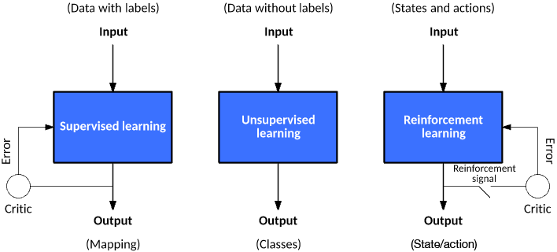
Types of Machine Learning Algorithms
Supervised Learning
Unsupervised
Learning
Reinforcement
Learning

Slide 8
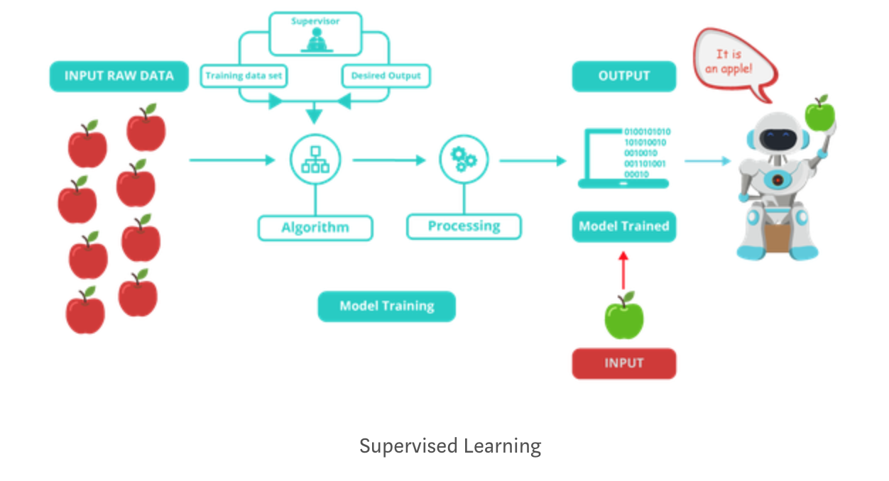
Supervised Learning
Supervised learning is the machine learning task of learning a function that maps an input to an output based on example of input-output pairs

Slide 9
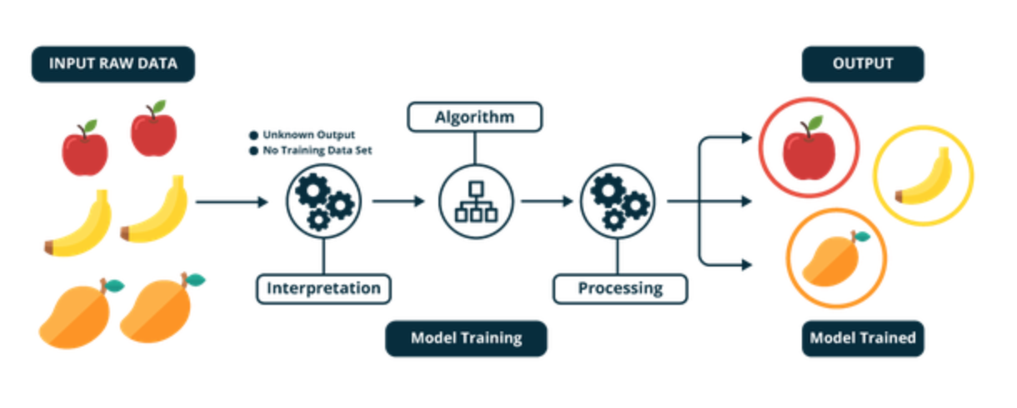
Unsupervised Learning
Unsupervised learning is a machine learning algorithm used to draw inferences from datasets consisting of input data without labeled responses
Unsupervised Learning

Slide 10
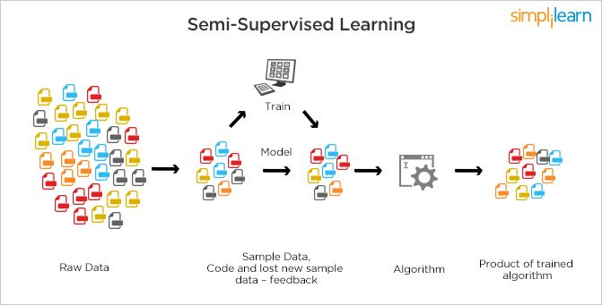
Semi-Supervised Learning
Semi-supervised learning is a machine learning technique that makes use of small amount of labeled data and large amount of unlabeled data
Semi-supervised learning

Slide 11
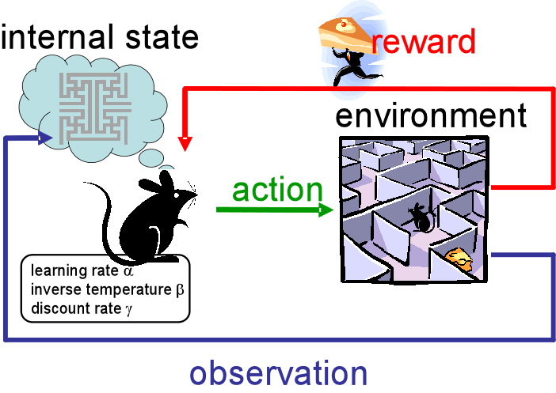
Reinforcement Learning
Reinforcement Learning is a machine learning technique that allows the machine or software agent to learn its behavior based on feedback from the environment
This behavior can be learnt once and for all, or keep on adapting as time goes by
Reinforcement Learning

Slide 12
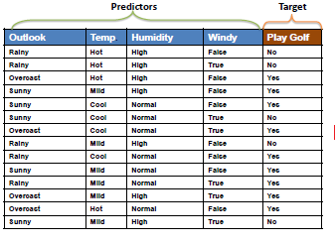
Sample dataset: play golf: Yes or No

Slide 13
Terminology
Features
The number of features or distinct traits that can be used to describe each item in a quantitative manner
Samples
A sample is an item to process (e.g. classify). It can be a document, a picture, a sound, a video, a row in database or CSV file
Feature vector
an n-dimensional vector of numerical features that represent some object
Feature extraction
Preparation of feature vector
Training set
Set of data to discover potentially predictive relationships.

Slide 14
Techniques in Machine Learning
Classification : predicting the class from observations
Clustering : grouping the observations
Regression : predicting the value from observations

Slide 15
An architecture for operationalizing Machine Learning
Given a dataset of instances of size N, create a model to predict the outcomes
Tasks involved in designing a model:
Data Wrangling
Feature Analysis/Extraction
Model Selection/Building
Model Evaluation
Build Phase
Training Data
Feature Vectors
Estimation Algorithm
Labels
Operational Phase
New Data
Feature Vectors
Predictive Model
Prediction

Slide 16
Classification

Slide 17
Types of classification algorithms
Nearest Neighbor (k-nearest neighbors (kNN))
Naive Bayes Classifier
Support Vector Machines (SVM)
Decision Trees
Boosted Trees
Random Forest
https://medium.com/@sifium/machine-learning-types-of-classification-9497bd4f2e14
https://www.analyticsvidhya.com/blog/2017/09/common-machine-learning-algorithms/

Slide 18
k-nearest neighbors (k-NN)

Slide 19
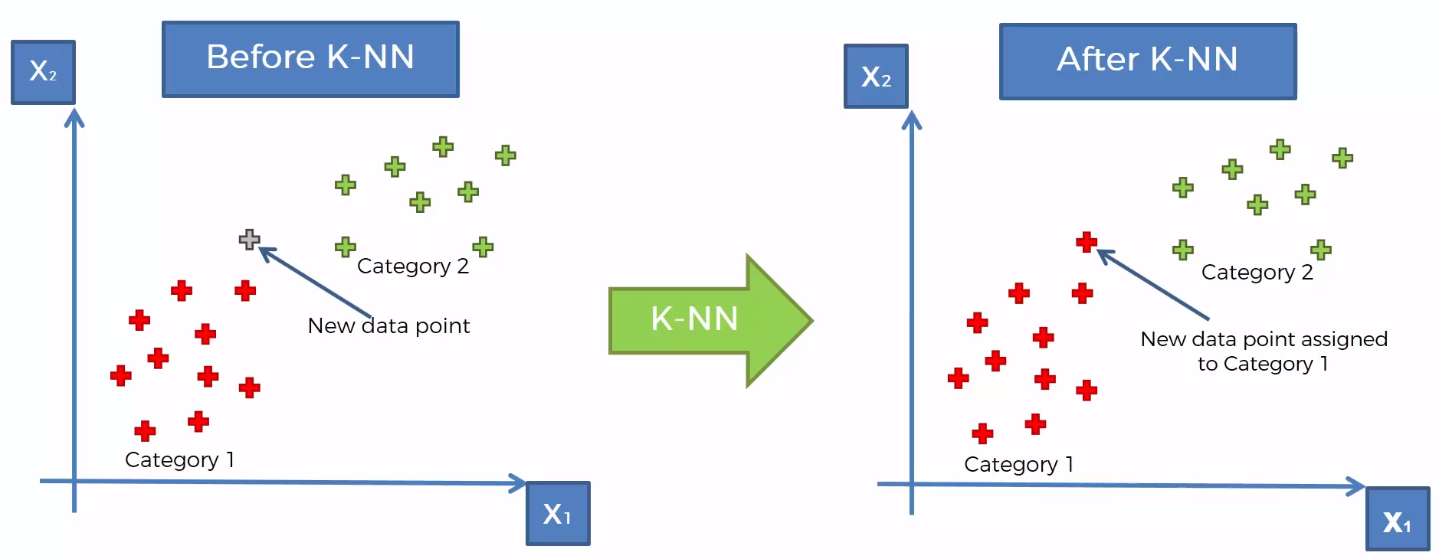
k-nearest neighbors (k-NN)
https://www.udemy.com/machinelearning/learn/v4/content
https://www.quora.com/How-is-the-k-nearest-neighbor-algorithm-different-from-k-means-clustering

Slide 20
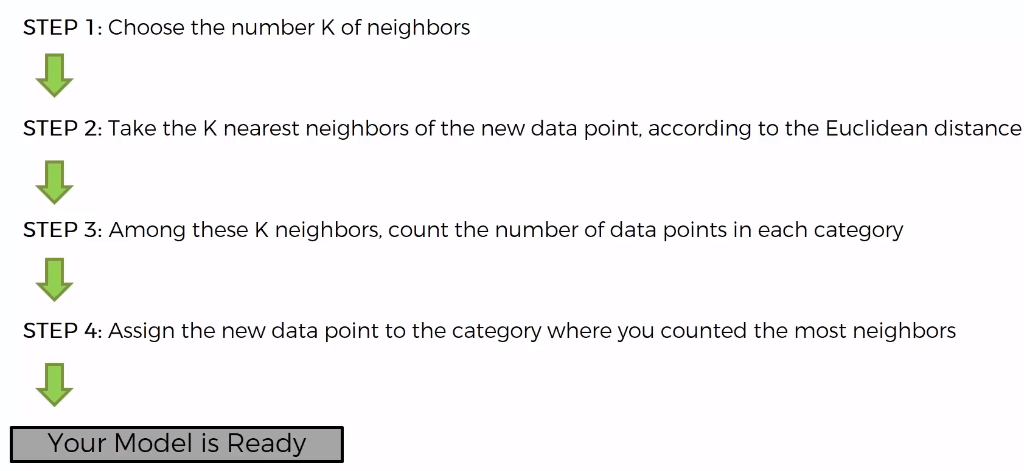
k-nearest neighbors (k-NN)
https://www.udemy.com/machinelearning/learn/v4/content
https://www.quora.com/How-is-the-k-nearest-neighbor-algorithm-different-from-k-means-clustering

Slide 21
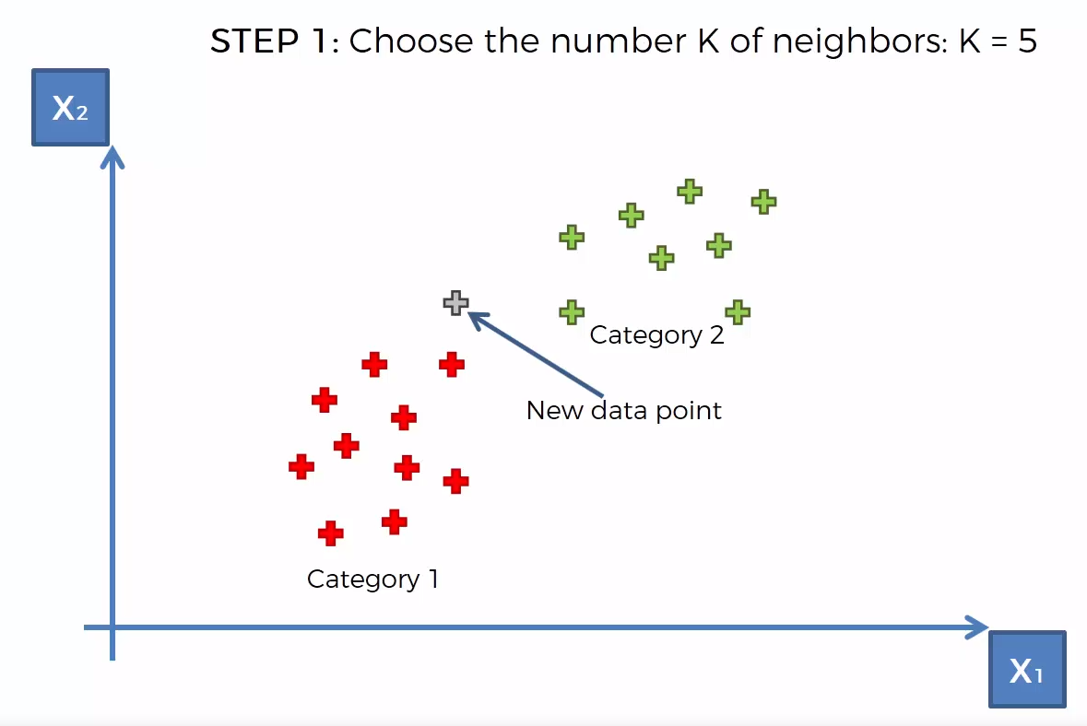
k-nearest neighbors (k-NN)
https://www.udemy.com/machinelearning/learn/v4/content
https://www.quora.com/How-is-the-k-nearest-neighbor-algorithm-different-from-k-means-clustering

Slide 22
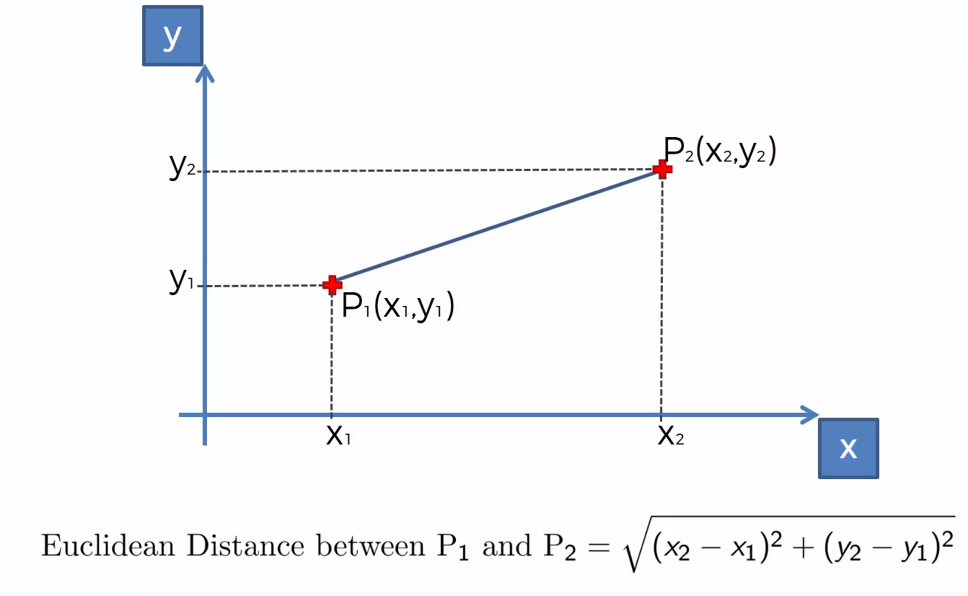
k-nearest neighbors (k-NN)
https://www.udemy.com/machinelearning/learn/v4/content
https://www.quora.com/How-is-the-k-nearest-neighbor-algorithm-different-from-k-means-clustering

Slide 23
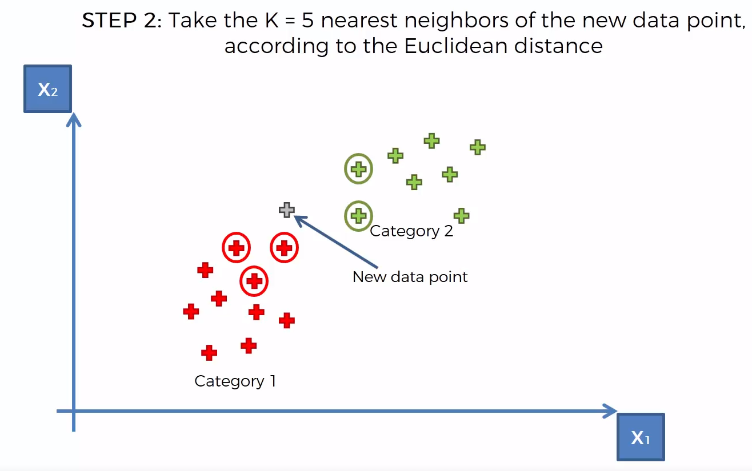
k-nearest neighbors (k-NN)
https://www.udemy.com/machinelearning/learn/v4/content
https://www.quora.com/How-is-the-k-nearest-neighbor-algorithm-different-from-k-means-clustering

Slide 24
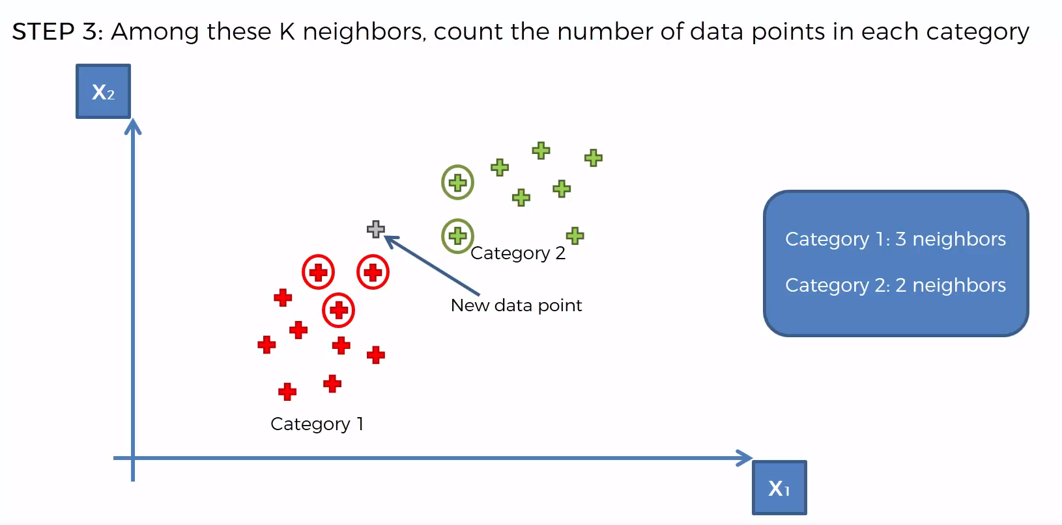
k-nearest neighbors (k-NN)
https://www.udemy.com/machinelearning/learn/v4/content
https://www.quora.com/How-is-the-k-nearest-neighbor-algorithm-different-from-k-means-clustering

Slide 25
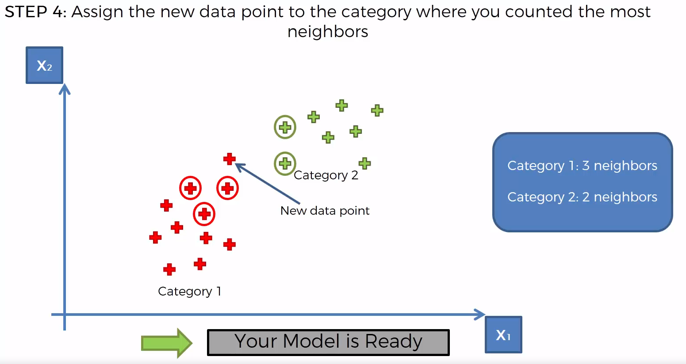
k-nearest neighbors (k-NN)
https://www.udemy.com/machinelearning/learn/v4/content
https://www.quora.com/How-is-the-k-nearest-neighbor-algorithm-different-from-k-means-clustering

Slide 26
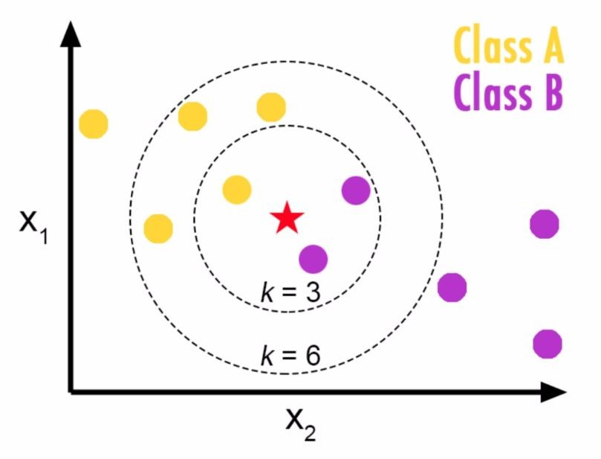
k-nearest neighbors (k-NN)
Choosing a K will affect what class a new point is assigned to:

Slide 27
Naive Bayes Classifier

Slide 28
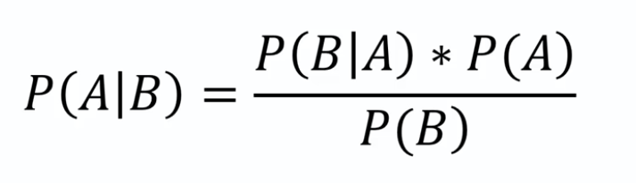
Naive Bayes Classifier
It is a classification technique based on Bayes’ Theorem
assumption of independence among predictors.
In simple terms, a Naive Bayes classifier assumes that the presence of a particular feature in a class is unrelated to the presence of any other feature
Bayes’ Theorem
https://medium.com/@sifium/machine-learning-types-of-classification-9497bd4f2e14

Slide 29
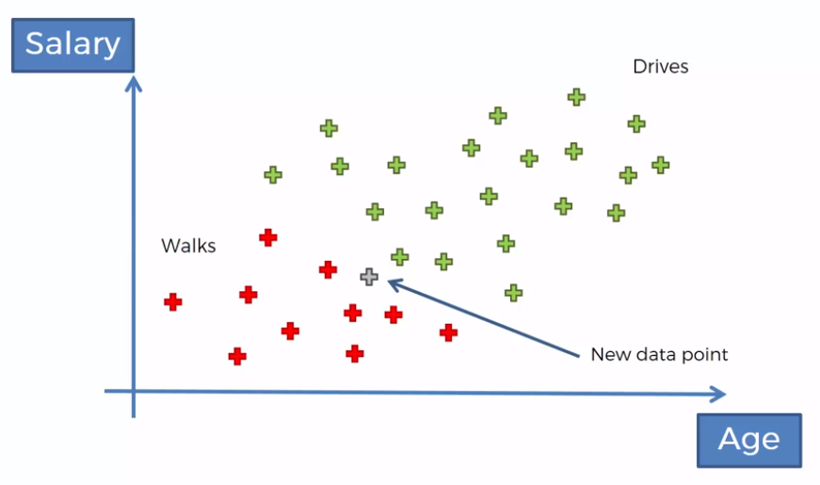
Naive Bayes Classifier
https://www.udemy.com/machinelearning/learn/v4/content
https://medium.com/@sifium/machine-learning-types-of-classification-9497bd4f2e14

Slide 30
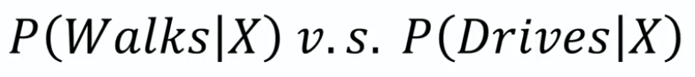
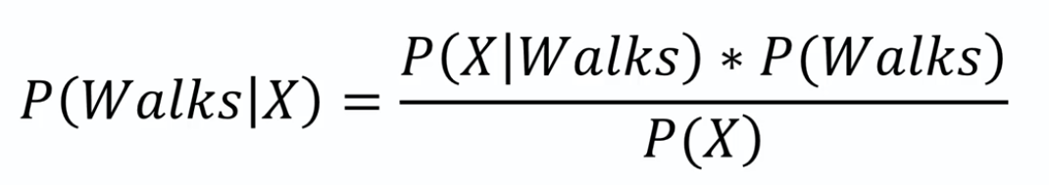
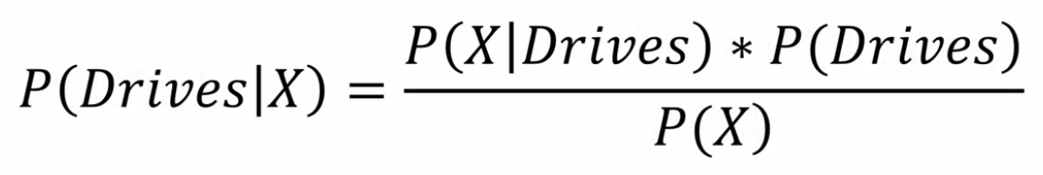
Naive Bayes Classifier
https://www.udemy.com/machinelearning/learn/v4/content
https://medium.com/@sifium/machine-learning-types-of-classification-9497bd4f2e14

Slide 31
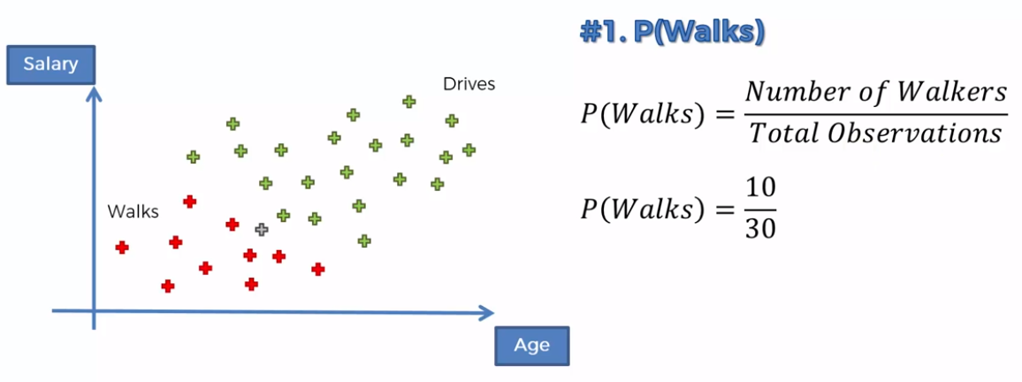
Naive Bayes Classifier
https://www.udemy.com/machinelearning/learn/v4/content
https://medium.com/@sifium/machine-learning-types-of-classification-9497bd4f2e14

Slide 32
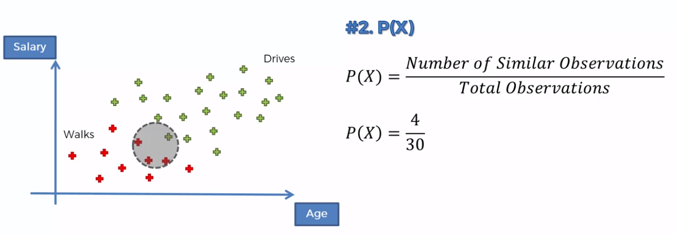
Naive Bayes Classifier
https://www.udemy.com/machinelearning/learn/v4/content
https://medium.com/@sifium/machine-learning-types-of-classification-9497bd4f2e14

Slide 33
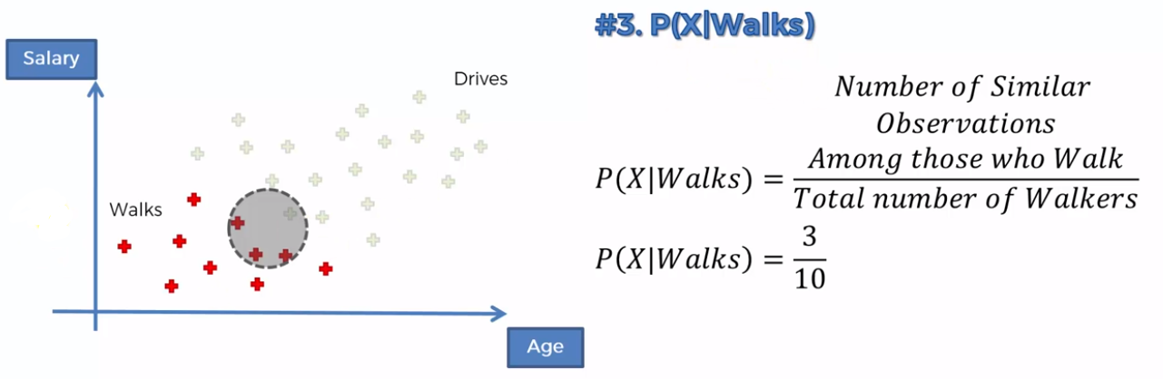
Naive Bayes Classifier
https://www.udemy.com/machinelearning/learn/v4/content
https://medium.com/@sifium/machine-learning-types-of-classification-9497bd4f2e14

Slide 34
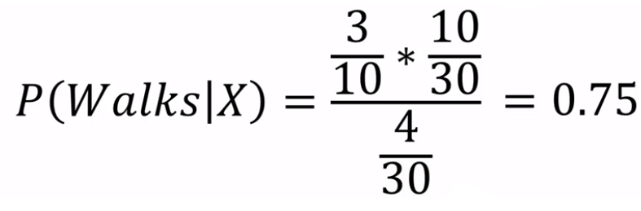
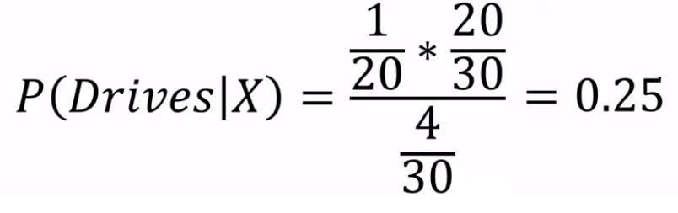
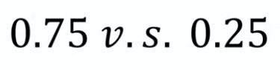
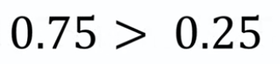
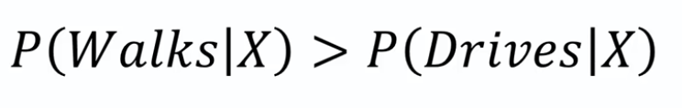
Naive Bayes Classifier
https://www.udemy.com/machinelearning/learn/v4/content
https://medium.com/@sifium/machine-learning-types-of-classification-9497bd4f2e14

Slide 35
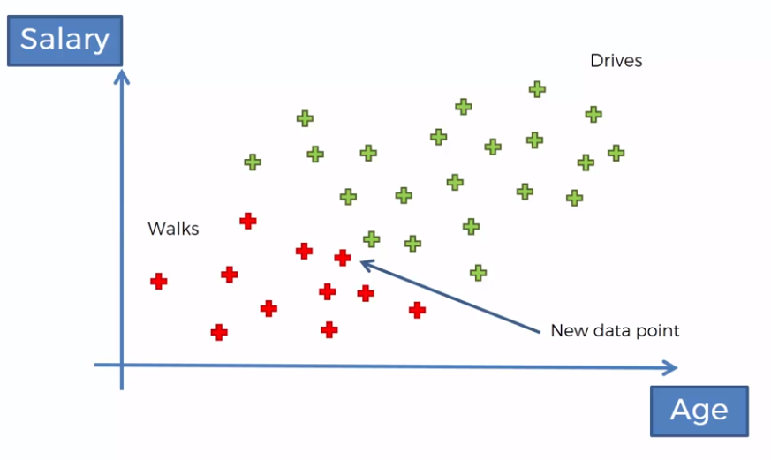
Naive Bayes Classifier
https://www.udemy.com/machinelearning/learn/v4/content
https://medium.com/@sifium/machine-learning-types-of-classification-9497bd4f2e14

Slide 36
Support Vector Machines (SVM)

Slide 37
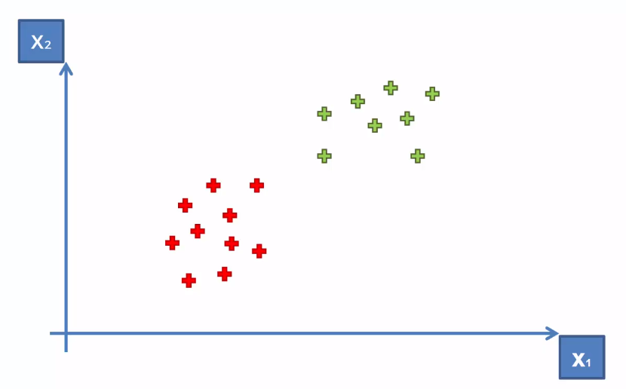
Support Vector Machines (SVM)
Purpose of the classifier is how we can create a boundary between two classes
How can we separate these points?
https://www.udemy.com/machinelearning/learn/v4/content
https://medium.com/@sifium/machine-learning-types-of-classification-9497bd4f2e14

Slide 38
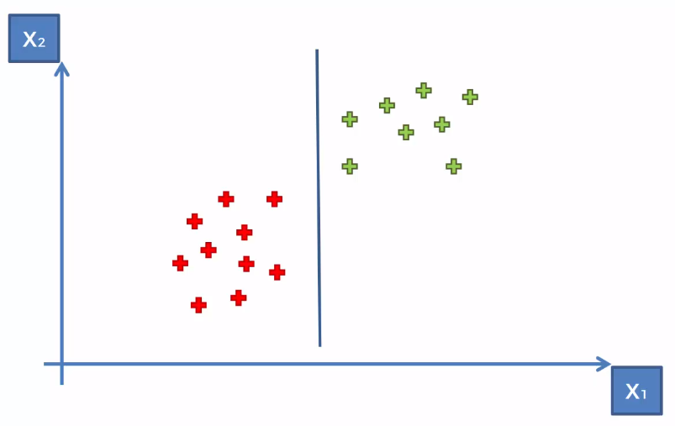
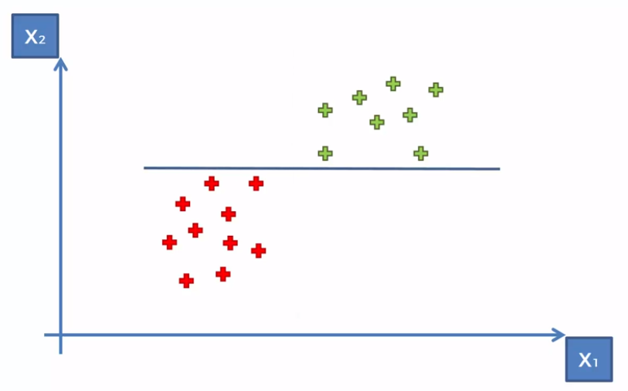
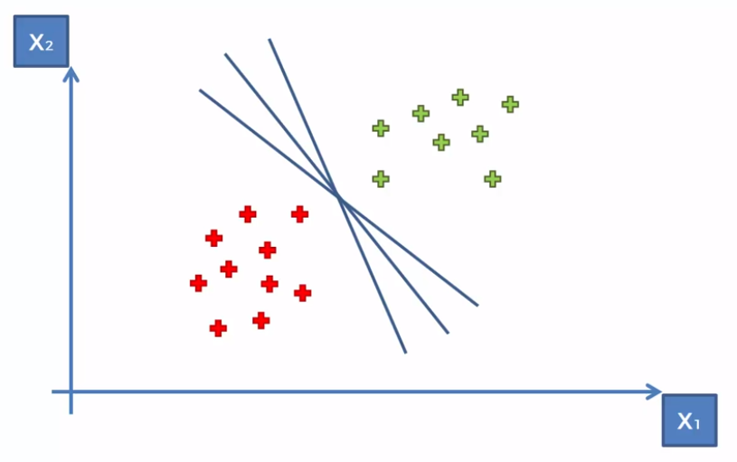
Support Vector Machines (SVM)
How can we separate these points?
https://www.udemy.com/machinelearning/learn/v4/content
https://medium.com/@sifium/machine-learning-types-of-classification-9497bd4f2e14

Slide 39
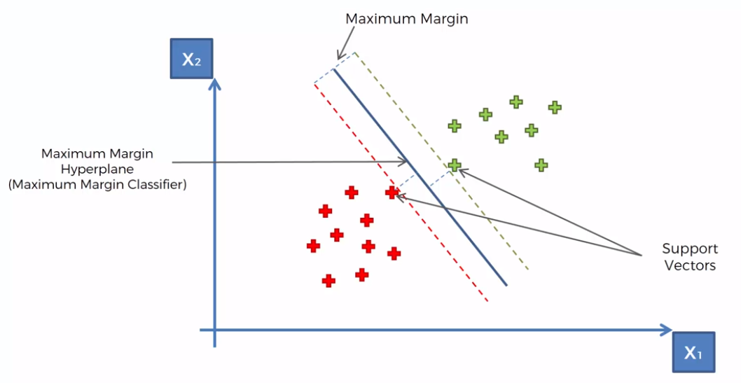
Support Vector Machines (SVM)
https://www.udemy.com/machinelearning/learn/v4/content
https://medium.com/@sifium/machine-learning-types-of-classification-9497bd4f2e14

Slide 40
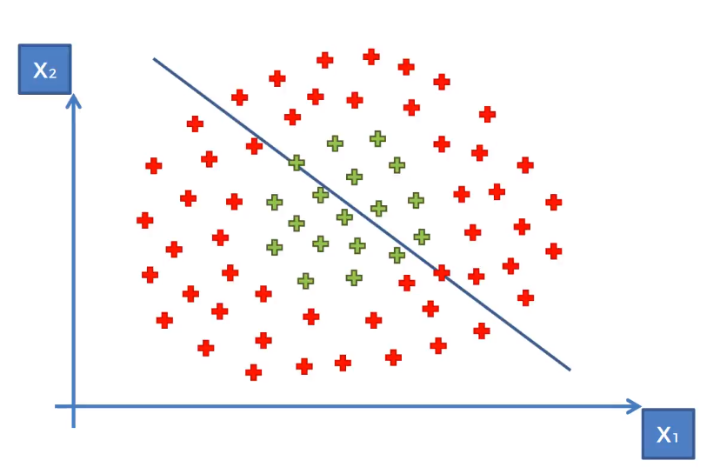
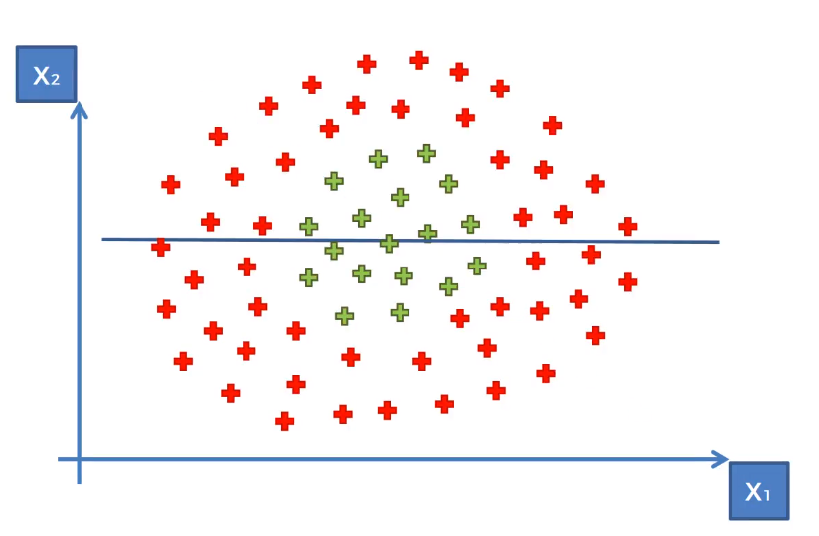
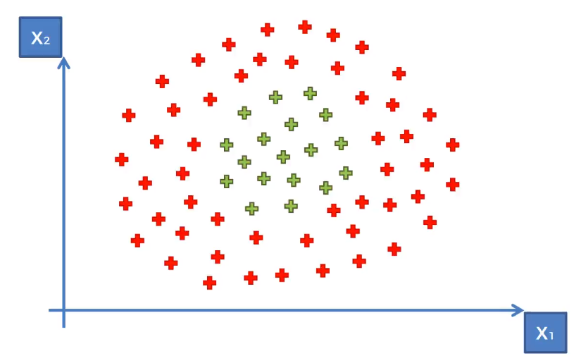
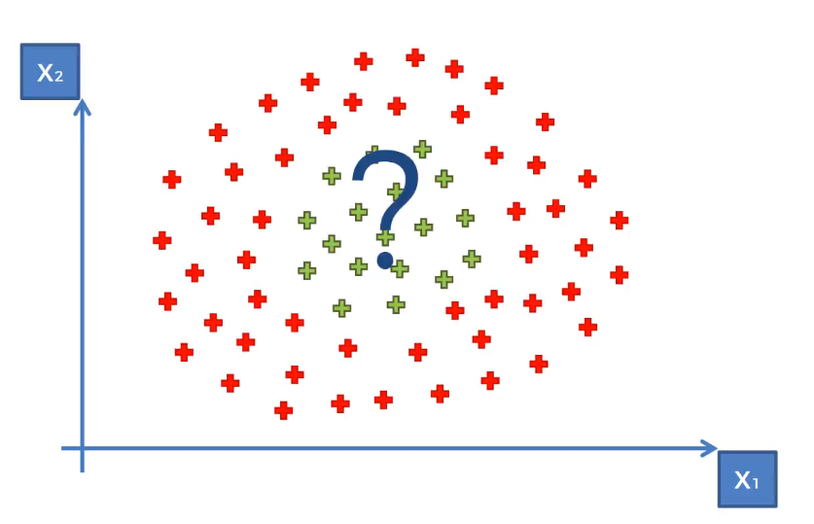
Kernel SVM
What about these points?
https://www.udemy.com/machinelearning/learn/v4/content
https://medium.com/@sifium/machine-learning-types-of-classification-9497bd4f2e14

Slide 41
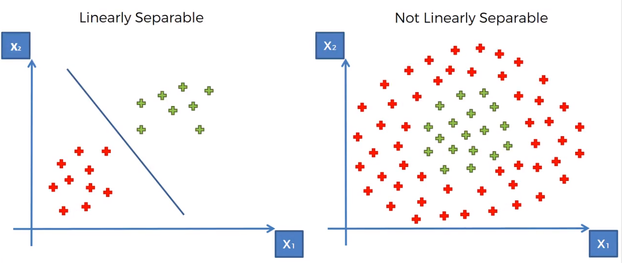
Kernel SVM
Liner Separability
https://www.udemy.com/machinelearning/learn/v4/content
https://medium.com/@sifium/machine-learning-types-of-classification-9497bd4f2e14

Slide 42
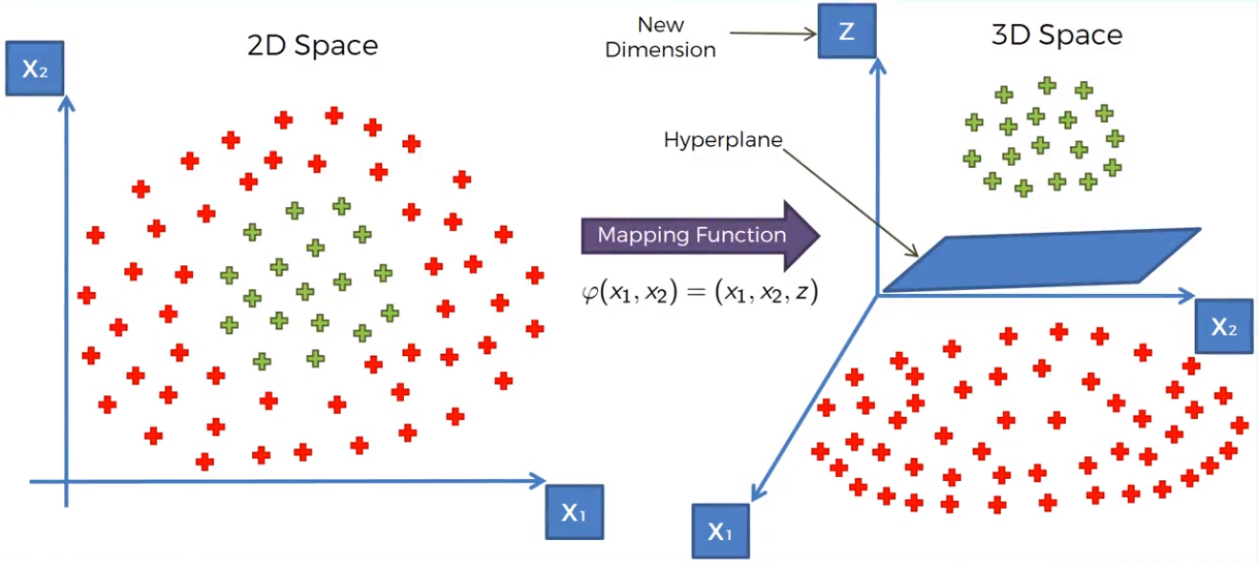
Kernel SVM
Mapping to higher dimension
https://www.udemy.com/machinelearning/learn/v4/content
https://medium.com/@sifium/machine-learning-types-of-classification-9497bd4f2e14

Slide 43
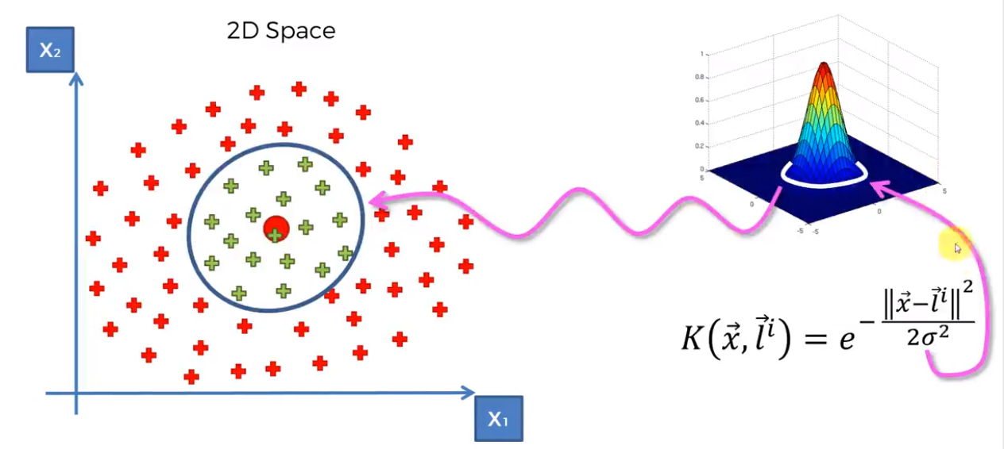
Kernel SVM
The Gaussian RBF Kernel
https://www.udemy.com/machinelearning/learn/v4/content
https://medium.com/@sifium/machine-learning-types-of-classification-9497bd4f2e14

Slide 44
Evaluating Model
A machine learning model’s performance is considered good based on the prediction and how well it generalizes on an independent test dataset
Error
Difference between the actual output and predicted output is the error
Machine learning algorithms tries to generate a model to minimize the error

Slide 45
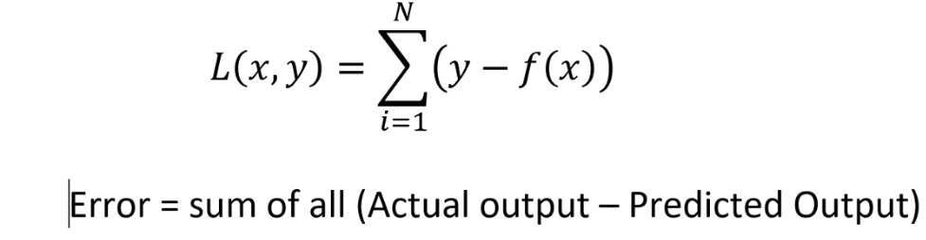
Model Evaluation
Models are assessed based on the prediction error on a new test dataset
Bias Error
Bias is how far the predicted values from the actual values
If the average predicted values are far off from the actual values then the bias is high

Slide 46
Variance Error
Variance is the amount that the estimate of the target function will change if different training data was used.
Variance measures how far a data set is spread out. The technical definition is “The average of the squared differences from the mean”
The data set 12, 12, 12, 12, 12 has a var. of zero (the numbers are identical).
The data set 12, 12, 12, 12, 13 has a var. of 0.167; a small change in the numbers equals a very small var.
The data set 12, 12, 12, 12, 13,013 has a var. of 28171000; a large change in the numbers equals a very large number.
https://machinelearningmastery.com/gentle-introduction-to-the-bias-variance-trade-off-in-machine-learning/

Slide 47
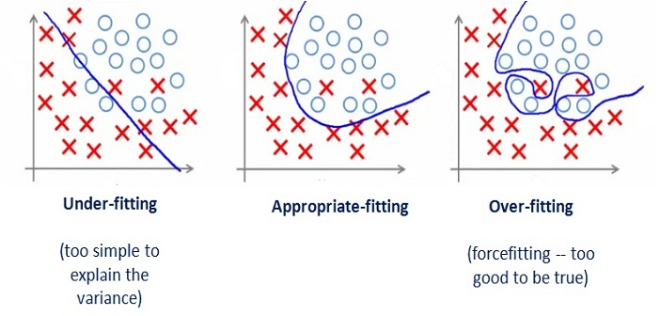
Underfitting and Overfitting
Underfitting occurs if the model or algorithm shows low variance but high bias
Overfitting occurs if the model or algorithm shows low bias but high variance.

Slide 48
Metrics in Classification
False Positives & False Negatives
Confusion Matrix
Accuracy
Precision
Recall
F1 score

Slide 49
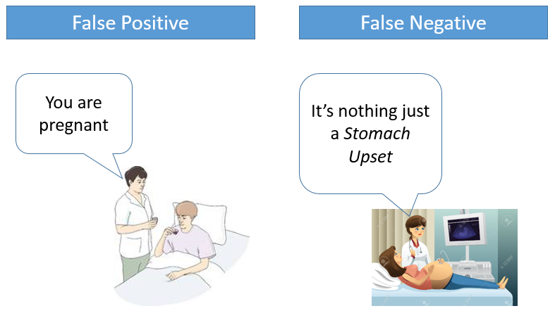
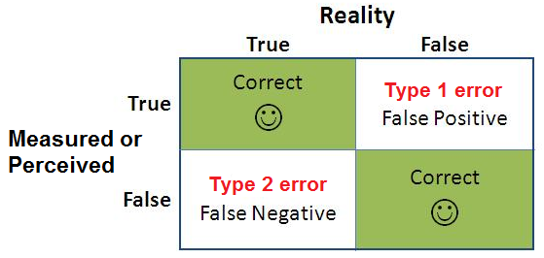
False Positives & False Negatives
A false positive is where you receive a positive result for a test, when you should have received a negative results. A false positive is usually called a Type I error.
A false negative is where you receive a negative test result, but you should have got a positive test result . A false negative is usually called a Type II error.
http://www.statisticshowto.com/false-positive-definition-and-examples/

Slide 50

Metrics
accuracy =
true positives + true negatives / total
precision =
true positives / (true positives + false positives)
recall =
true positives / (false negatives + true positives)
F1 score =
2 * ((precision * recall) / (precision + recall))

Slide 51
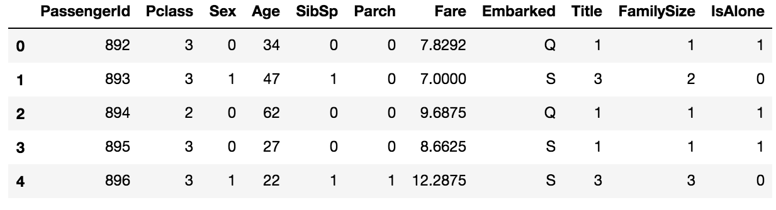
Titanic Survival Challenge

Slide 52
Retrospection-I: Modeling
Objective: Predict who survived the sinking of the Titanic
Is there a specific outcome for the objective? Yes, survived or not survived
Is it a Numerical outcome or Class outcome? Class (survived or not survived)
What type of machine learning is this: Supervised classification
Suitable models for this type of learning KNN, SVM (see cheat sheet)
Do we have the data or is data scraping needed: Already have data
Load data into Pandas using pd read_csv("")

Slide 53
Retrospection-II: Analyzing the described data
Which features are available in the dataset?
Which features are categorical?
Which features are numerical?
Which features are mixed data types?
Which features may contain errors or typos?
Which features contain blank, null or empty values?
What are the data types for various features?

Slide 54
Steps to build model
Read the data
Identify the features
Fix columns with null values
Correct the data by dropping irrelevant columns
Convert the columns with categorical values
Train the model
Evaluate the model
\

Slide 55
Clustering

Slide 56
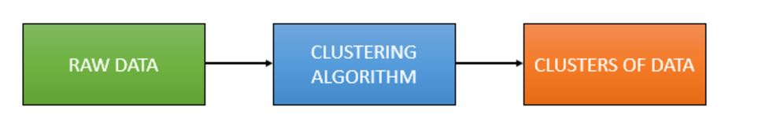
Clustering
Clustering is the grouping of objects such that similar objects fall in the same group

Slide 57
Clustering
Clustering is an unsupervised learning algorithm that will attempt to group similar clusters together in your data
So what does a typical clustering problem look like?
Clustering Similar Documents
Clustering Customers based on Features
Market Segmentation
Identifying similar physical groups

Slide 58
Clustering Algorithms
Method name | Parameters | Scalability | Use case | Geometry (metric used)
K-Means | number of clusters | Very large n_samples, medium n_clusterswith MiniBatch code | General-purpose, even cluster size, flat geometry, not too many clusters | Distances between points
Affinity propagation | damping, sample preference | Not scalable with n_samples | Many clusters, uneven cluster size, non-flat geometry | Graph distance (e.g. nearest-neighbor graph)
Mean-shift | bandwidth | Not scalable with n_samples | Many clusters, uneven cluster size, non-flat geometry | Distances between points
Spectral clustering | number of clusters | Medium n_samples, small n_clusters | Few clusters, even cluster size, non-flat geometry | Graph distance (e.g. nearest-neighbor graph)
Ward hierarchical clustering | number of clusters | Large n_samples and n_clusters | Many clusters, possibly connectivity constraints | Distances between points
Agglomerative clustering | number of clusters, linkage type, distance | Large n_samples and n_clusters | Many clusters, possibly connectivity constraints, non Euclidean distances | Any pairwise distance
DBSCAN | neighborhood size | Very large n_samples, medium n_clusters | Non-flat geometry, uneven cluster sizes | Distances between nearest points
Gaussian mixtures | many | Not scalable | Flat geometry, good for density estimation | Mahalanobis distances to centers
Birch | branching factor, threshold, optional global clusterer. | Large n_clustersand n_samples | Large dataset, outlier removal, data reduction. | Euclidean distance between points

Slide 59
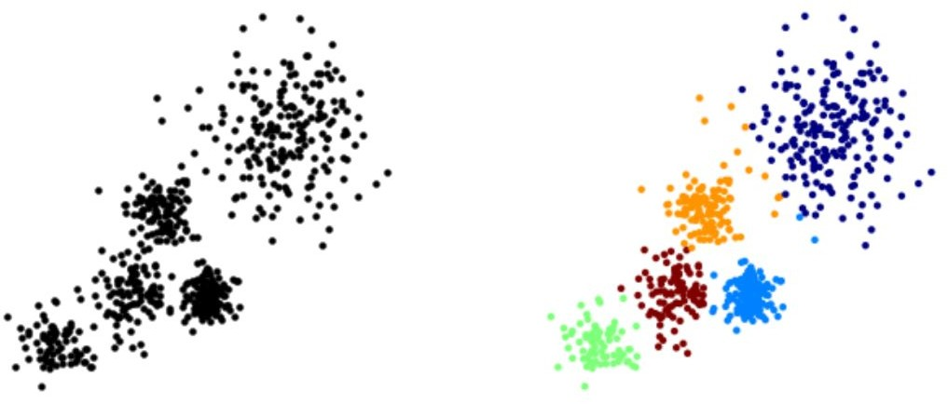
Clustering
The overall goal is to divide data into distinct groups such that observations within each group are similar

Slide 60
K Means Clustering

Slide 61
K Means Clustering
The K Means Algorithm
Choose a number of Clusters “K”
Randomly assign each point to a cluster
Until clusters stop changing, repeat the following:
For each cluster, compute the cluster centroid by taking the mean vector of points in the cluster
Assign each data point to the cluster for which the centroid is the closest

Slide 62
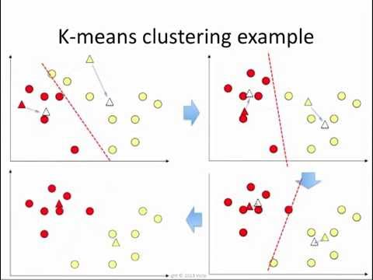
K Means Clustering

Slide 63

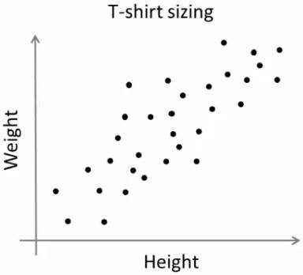
K-Means
T-shirt size problem
Consider a company, which is going to release a new model of T-shirt to market
Obviously they will have to manufacture models in different sizes to satisfy people of all sizes.
So the company make a data of people’s height and weight, and plot them on to a graph.
Company can’t create t-shirts with all the sizes. Instead, they divide people to Small, Medium and Large, and manufacture only these 3 models which will fit to all the people.

Slide 64
As a first step in finding a sensible initial partition(k=2)
Subject | A | B
1 | 1.0 | 1.0
2 | 1.5 | 2.0
3 | 3.0 | 4.0
4 | 5.0 | 7.0
5 | 3.5 | 5.0
6 | 4.5 | 5.0
7 | 3.5 | 4.5
 | Individual | Mean Vector (centroid)
Group 1 | 1 | (1.0, 1.0)
Group 2 | 4 | (5.0, 7.0)

Slide 65
Steps to do clustering
The remaining individuals are now examined in sequence and allocated to the cluster to which they are closest, in terms of Euclidean distance to the cluster mean.
The mean vector is recalculated each time a new member is added.
 | Cluster 1 |  | Cluster 2
Step | Individual | Mean Vector (centroid) | Individual | Mean Vector (centroid)
1 | 1 | (1.0, 1.0) | 4 | (5.0, 7.0)
2 | 1, 2 | (1.2, 1.5) | 4 | (5.0, 7.0)
3 | 1, 2, 3 | (1.8, 2.3) | 4 | (5.0, 7.0)
4 | 1, 2, 3 | (1.8, 2.3) | 4, 5 | (4.2, 6.0)
5 | 1, 2, 3 | (1.8, 2.3) | 4, 5, 6 | (4.3, 5.7)
6 | 1, 2, 3 | (1.8, 2.3) | 4, 5, 6, 7 | (4.1, 5.4)

Slide 66
Steps to do clustering
Now the initial partition has changed, and the two clusters at this stage having the following characteristics
 | Individual | Mean Vector (centroid)
Cluster 1 | 1, 2, 3 | (1.8, 2.3)
Cluster 2 | 4, 5, 6, 7 | (4.1, 5.4)

Slide 67
Steps to do clustering
But we cannot yet be sure that each individual has been assigned to the right cluster. So, we compare each individual’s distance to its own cluster mean and to that of the opposite cluster.
Individual | Distance to mean (centroid) of Cluster 1 | Distance to mean (centroid) of Cluster 2
1 | 1.5 | 5.4
2 | 0.4 | 4.3
3 | 2.1 | 1.8
4 | 5.7 | 1.8
5 | 3.2 | 0.7
6 | 3.8 | 0.6
7 | 2.8 | 1.1

Slide 68
Steps to do clustering
Only individual 3 is nearer to the mean of the opposite cluster (Cluster 2) than its own (Cluster 1)
In other words, each individual's distance to its own cluster mean should be smaller that the distance to the other cluster's mean (which is not the case with individual 3)
Thus, individual 3 is relocated to Cluster 2
 | Individual | Mean Vector (centroid)
Cluster 1 | 1, 2 | (1.3, 1.5)
Cluster 2 | 3, 4, 5, 6, 7 | (3.9, 5.1)

Slide 69
References
http://www-bcf.usc.edu/~gareth/ISL/ISLR%20Sixth%20Printing.pdf
https://web.stanford.edu/~schmit/cme193/lec/lec5.pdf
http://machinelearningmastery.com/machine-learning-in-python-step-by-step/
http://scikit-learn.org/stable/auto_examples/linear_model/plot_ols.html
https://www.analyticsvidhya.com/blog/2015/08/comprehensive-guide-regression/
http://scikit-learn.org/stable/modules/clustering.html
http://scikit-learn.org/stable/auto_examples/cluster/plot_kmeans_digits.html
http://www.kdnuggets.com/2015/11/seven-steps-machine-learning-python.html/2
http://beancoder.com/linear-regression-stock-prediction/
http://opencv-python-tutroals.readthedocs.io/en/latest/py_tutorials/py_ml/py_kmeans/py_kmeans_understanding/py_kmeans_understanding.html
https://github.com/tarlen5/coursera_ml/blob/master/unit6/ex2_sklearn
https://www.kaggle.com/bburns/iris-exploration-pca-k-means-and-gmm-clustering
https://towardsdatascience.com/pca-using-python-scikit-learn-e653f8989e60

